Slide 1
Corporate Ownership on Housing Values (paper still trying to get out of bed)
Jeremy R. Groves, Ph.D., ACUE March 2026

Slide 2
Motivation
Housing markets in the United States are not well functioning when it comes to affordability.
Since about 2000, there has been a move toward corporate ownership of rental properties, with spikes after the 2007 financial crisis and post-Covid 19.
Corporations can usually outbid the more common single-family home buyers.
Previous research indicates neighborhoods with more owner-occupiers provide more stability and add to the formation of social capital.

Slide 3
Motivation
Renters have less “skin in the game” and thus may not be concerned with upkeep or neighborhood quality.
Large absentee landlords may not be as aware of conditions of the home leading to a higher share of “run down” properties.
Research by Federal Reserve Bank of Georgia found that corporate owners where 8% more likely to evict tenants.
Corporate owners “scooping up” properties exerts a higher pressure on the limited supply.
Corporate buyers tend to buy and renovate poor quality properties in low income and low-quality neighborhoods.
Corporate owners can exploit economies of scale.
Corporate owners can provide more stability in rental markets and provide programs such as rent-to-buy.

Slide 4
Literature
Wang, et al (1991)
Look at a unit transitioning from owner to renter occupied housing on the value of the unit, the nearby units, and the larger neighborhood.
Results find that the transition decreases value of the home itself, will spillover onto immediate neighbors, but the direct effect decreases with distance, and has a negative impact on overall neighborhoods.
Find a 3.7% discount for home sold as a rental home and each additional rental home in 5 home radius discounts another $430.
Discount decreases with distance with each home in the outer 8 home radius discounting at about $120.

Slide 5
Literature
Ihlanfeldt and Yang (2021)
Estimate the impact on effective tax rates and tax prices of renter occupied or vacation homes.
Estimate a census tract housing price index.
Break SFR into corporate and non-corporate and in- and out-of-state ownership.
Find every one percent increase in rental housing in neighborhood (census tract), depresses value by about 7% at a maximum (between 1.5% and 5%)

Slide 6
Data and Methodology
Property Tax Assessor Tax Rolls for Saint Louis County, MO spanning 2000 through 2023 (limited to 2010 due to census data limitations).
Search owner names for key text strings to define ownership type.
About 350,000 parcels over the ten year plus time frame.
Use tenure variable to limit to owner versus nonowner occupied homes.
Track ownership changes from sales by linking sales data to the ownership data.

Slide 7
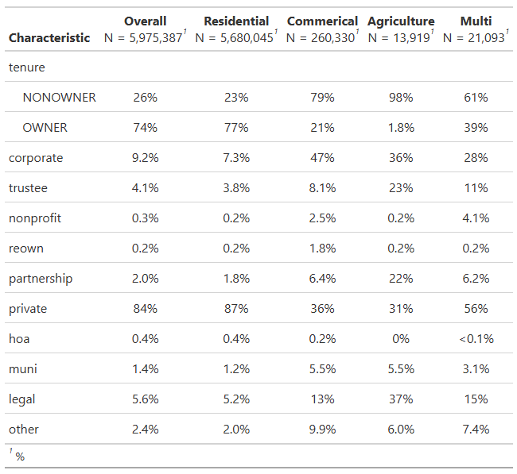
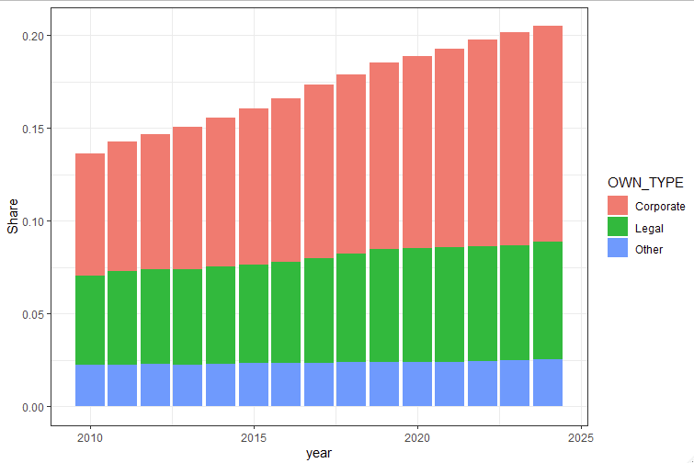
Data and Methodology

Slide 8
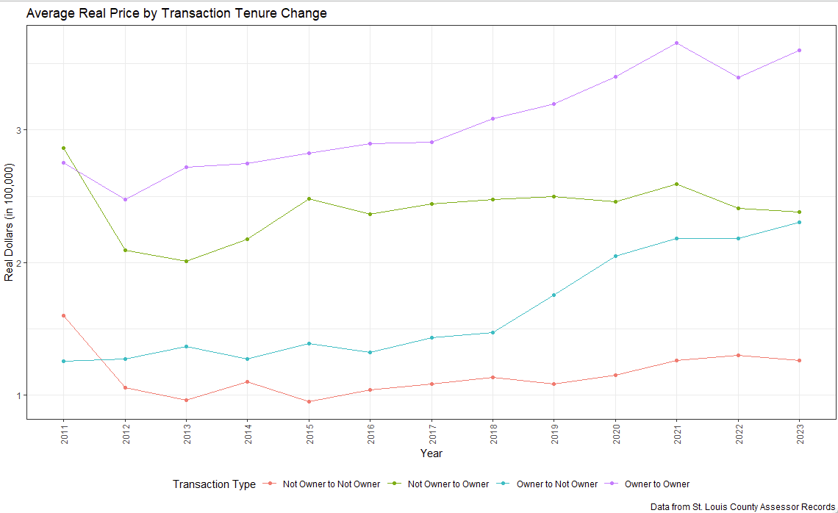
Data and Methodology

Slide 9
Data and Methodology
Define four types of ownership
Private: Owner Occupied Homes
Corporate: LLC or other clearly identified corporate body
Legal: Sole proprietor, partnerships, or trustees.
Other: Municipal, REO, HOA, Nonprofit/Church
Define four transition types based on reported tenure before and after sale.
Nonowner to Nonowner
Nonowner to Owner
Owner to Nonowner
Owner to Owner

Slide 10
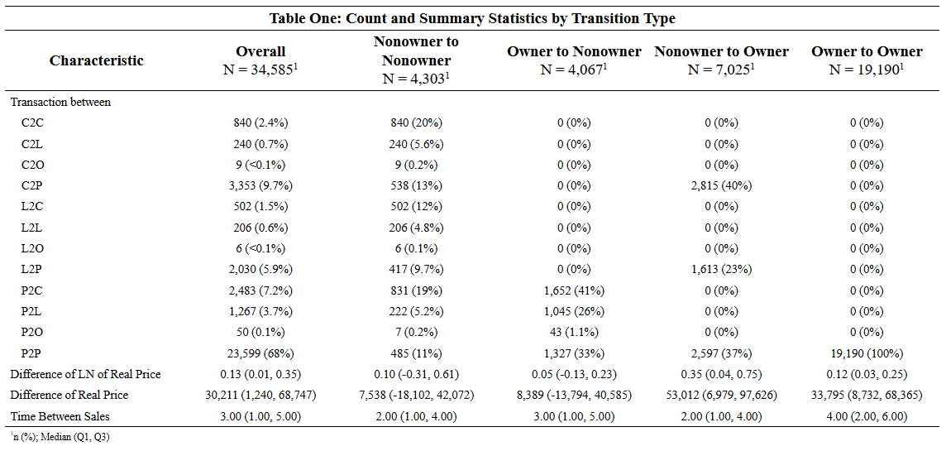
Data and Methodology

Slide 11
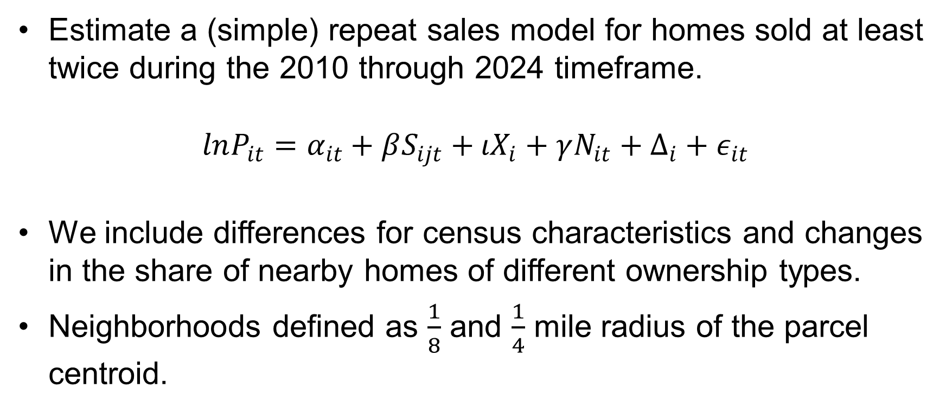
Data and Methodology
Estimate a (simple) repeat sales model for homes sold at least twice during the 2010 through 2024 timeframe.
$$lnP_{it}=α_{it}+βS_{ijt}+ιX_{i}+γN_{it}+Δ_{i}+ε_{it}$$
We include differences for census characteristics and changes in the share of nearby homes of different ownership types.
Neighborhoods defined as $\frac{1}{8}$ and $\frac{1}{4}$ mile radius of the parcel centroid.

Slide 12
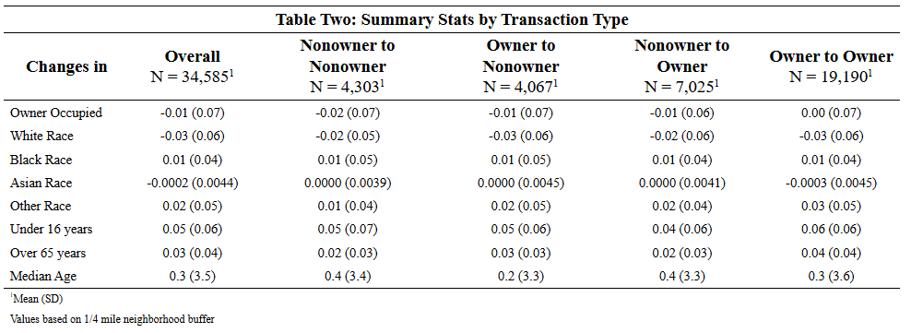
Data and Methodology

Slide 13
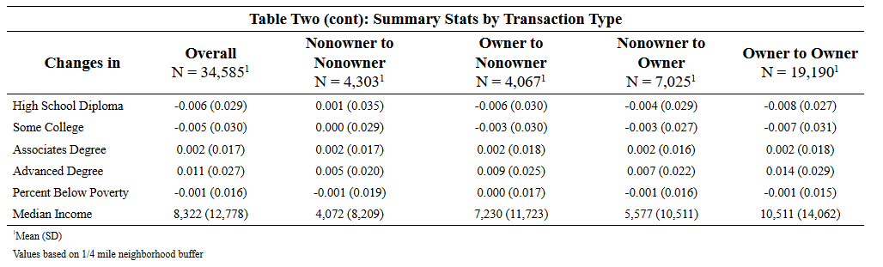
Data and Methodology

Slide 14
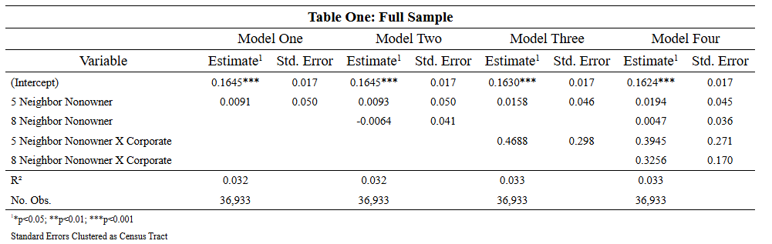
Results – Wang, et al Replication

Slide 15
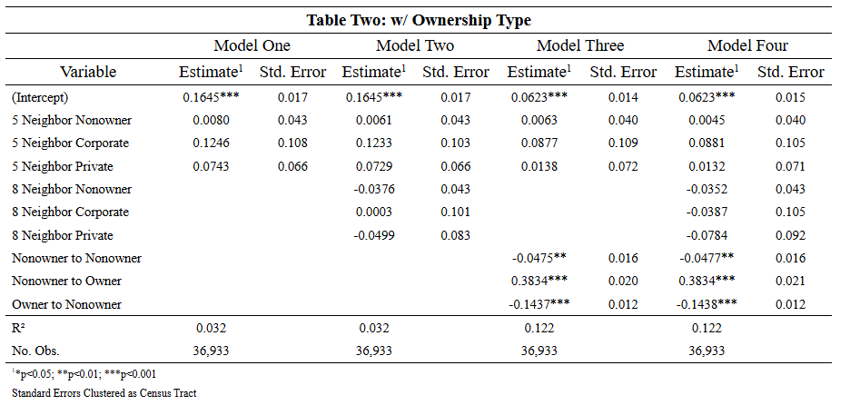
Results – Wang, et al Replication

Slide 16
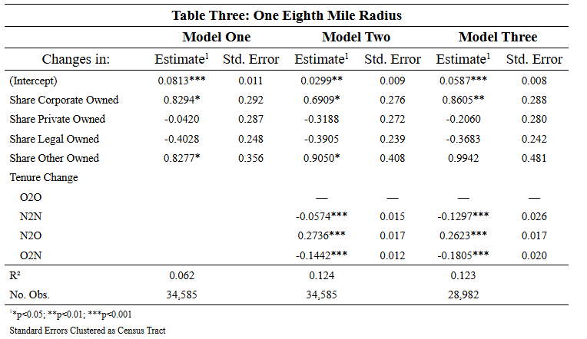
Results – St. Louis Data

Slide 17
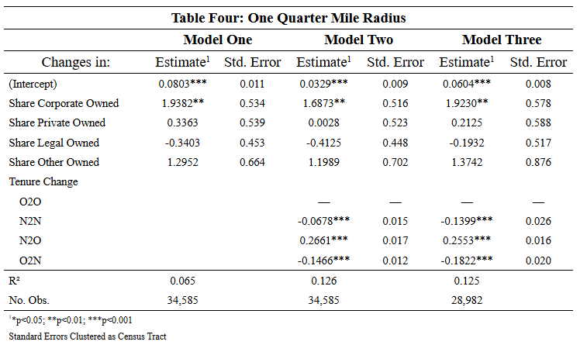
Results – St. Louis Data

Slide 18
Further Work
Working to identify total properties owned by owner
Issue is dealing with spelling errors
Dividing up the sample by neighborhood type
Research indicates that some areas are more likely to see increases in corporate ownership than others.
Splitting up corporate ownership by local, in-state, and out-of-state.

